Slide 1


Fundamentals of RM
RM System and Process
Leadership in RM
Incident Investigation
RM Tools & Challenges
RM in Industry
People & Org.
Application and Perspectives
On Becoming a
Leader in Risk Management
ENGG404 - Lecture
Chapter 5.1:
Introduction to Tools that
Support Leadership in
Risk Management

Slide 2
Learning Outcomes:
Recognize the tools for leadership in risk management, and explain the overall purpose of these tools.
Explain how to resolve risk concerns by applying a risk reduction hierarchy (order of effectiveness).
Interpret, critique, and create the following risk management tools:
Field Level Risk Assessment
Semi-Quantitative Risk Assessment
Apply all of these tools as a rudimentary skill of leadership to observe, interact, commend or intervene / coach employees in the work-place.
Explain how to ask and the benefits of asking “open-ended questions”.
Chapter 5.1 Tools for Risk Management
2
Notes:
2

Slide 3
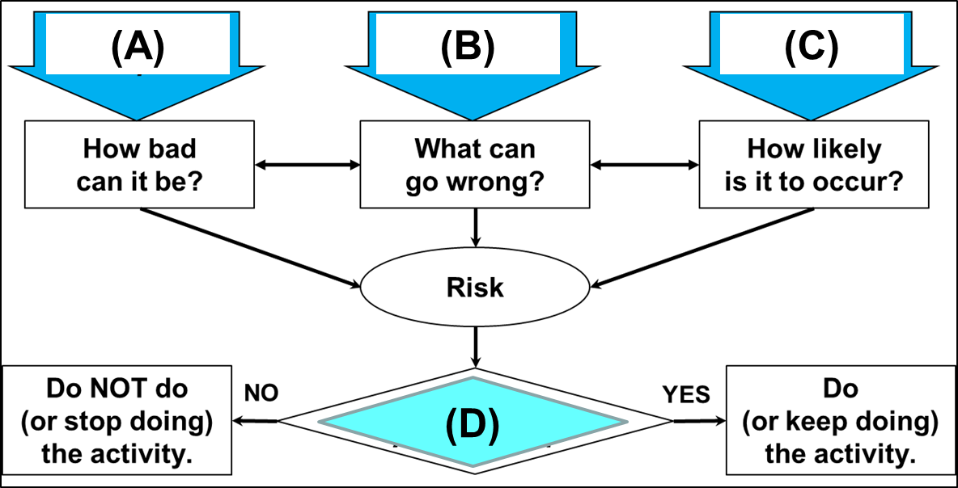
ALE #1: “Something Bad Could Happen”:
Please confer (pen-to-paper, respond on MM-Poll):
Select the best response for each item:
Chapter 5.1 Tools for Risk Management
3
Notes:
3

Slide 4
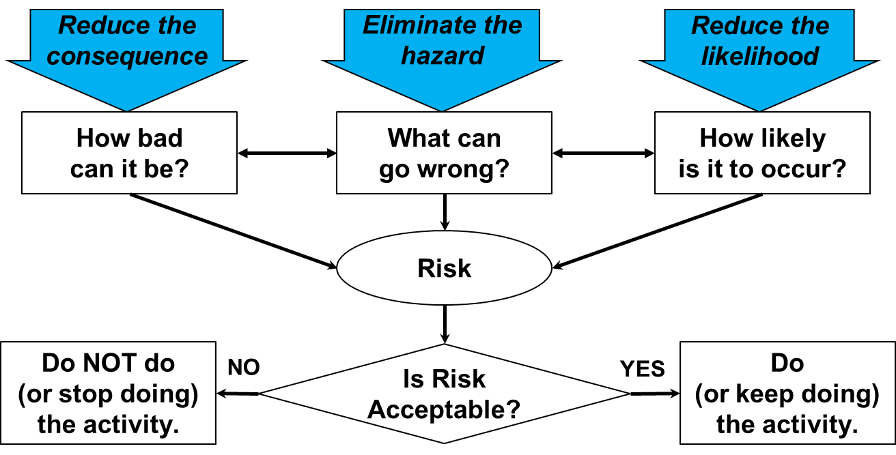
Recall “Something Bad Could Happen”:
Risk is a function of consequence and likelihood of an uncontrolled hazard.
Hazard: A potential source of serious harm to people, environment, assets or production.
Consequence: The harm imparted on people, environment, assets or production, when the hazard is uncontrolled
Chapter 5.1 Tools for Risk Management
4
Notes:
4

Slide 5
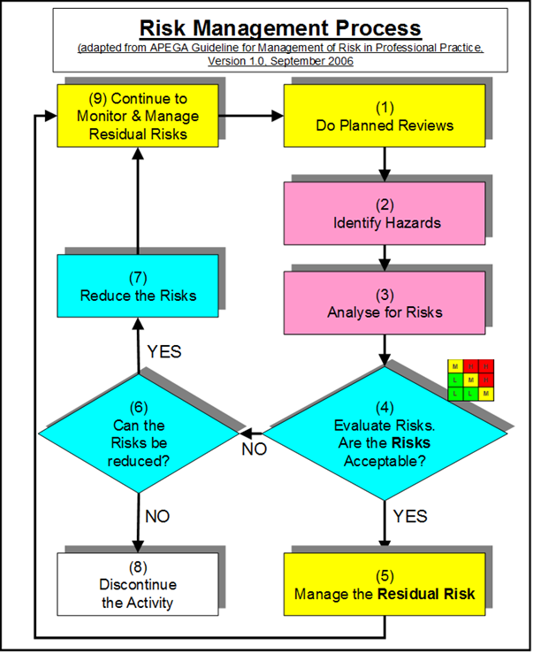

Risk Management Work Process
Recall the RM work process:
Risk determined before / without
control measures, but can also
be determined with control
measures.
Various tools can be used to
analyze and reduce risk to an
acceptable level i.e. reduce
consequence or likelihood, or
eliminate the hazard.
Chapter 5.1 Tools for Risk Management
5
Notes:
5

Slide 6
Risk Reduction Tools:
In this course:
FLRA
SQRA
Evaluations (Audits)
What-If Analysis
FLRAs
SQRAs
JSAs
Checklists
Evaluations
(Audits)
What tools have you used in your work terms? (Show of hands)
Chapter 5.1 Tools for Risk Management
6
Notes:
6
The 5 tools we use and will be discussing each
Cdn Centre for OHS

Slide 7

Risk Reduction Tools:
Basic approach to these and similar risk reduction tools is the same:
“What are you doing?” (Activity)
“What can go wrong?” (Hazards and Risks)
“What are you going to do about it?”
(Control Measures)
Detailed Approach:
Any risk assessment methodology answers these questions in order to identify control measure to reduce risk to an acceptable level:
What are you doing? (Activity)
What could go wrong? (Hazard)
How bad could it be? (Consequence)
How likely is it to happen? (Likelihood)
Is it acceptable? (Risk)
What can I do about it? (Controls – Admin or Eng’g)
How does the control change the L and C?
(Reduce, remain unchanged, or increase?)
Chapter 5.1 Tools for Risk Management
7
Notes:
7
The 5 tools we use and will be discussing each
Cdn Centre for OHS

Slide 8
ALE #2: Apply Risk Reduction!
Please confer (pen-to-paper, open discussion):
Think of a common activity that “needs to be done carefully”:
Now, ask yourself these questions, and respond:
What are you doing i.e. what is the key activity?
What can go wrong i.e. what is a hazard or risk with that key activity?
What are you going to do about it i.e. what control measure
can you put in place to control or reduce that hazard or risk?
Chapter 5.1 Tools for Risk Management
8
Notes:
8

Slide 9
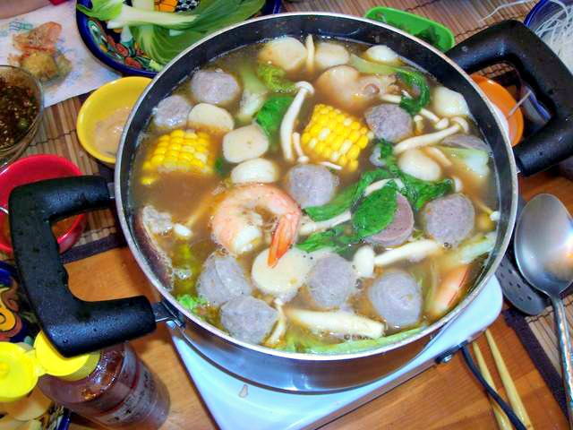

Example: Apply Risk Reduction to Making Soup
Common activity: “cooking noodle soup for lunch” and it needs to be done carefully to “prevent burning yourself”.
Responses to the questions:
Key activity: holding pot of boiling soup
Hazard or risk: hot handle, burn hand on hot handle
Control measure: use a pot holder or oven mitt.
Chapter 5.1 Tools for Risk Management
9
Notes:
9

Slide 10
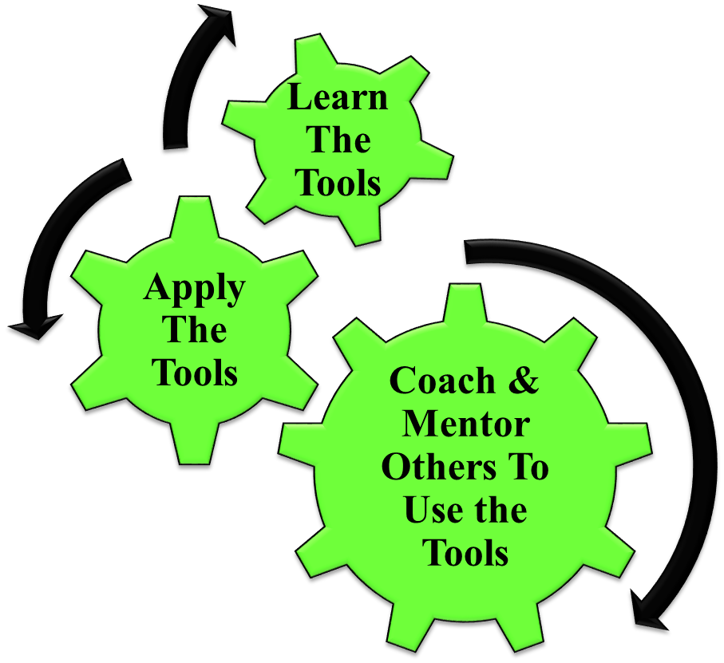
Leadership in Risk Management:
How Does This Apply To You as Engineers?
Chapter 5.1 Tools for Risk Management
10
Notes:
10

Slide 11

Leadership in Risk Management – Application & Coaching:
How Does This Apply To You as Engineers?
These powerful management tools can positively
influence safety culture in two ways:
Application:
  manage risks to acceptable
  levels and prevent incidents.
Coaching & Mentoring:
  Trains managers to be effective;
  Raises the visibility:
    “walk the talk”
    “lead by example”
  Engages workers and sets expectations for leader-worker interactions!
Q: How and Why?
Chapter 5.1 Tools for Risk Management
11
Notes:
11

Slide 12
Leadership in Risk Management – Application & Coaching:
How are these powerful management tools applied and why?
Apply this Key Leadership Skill:
Successful leaders must develop and practice
their ability to ask “open-ended questions”:
“Help me understand the work you are
doing and its hazards.”
“Can you explain to me how your work is
done, and how to improve it?”
“Can you tell me about the hazards and safeguards
that are associated with your work?”
Why?
Demonstrates management commitment and leadership (#1 MLCA)
Coach in a visible and effective manner (supportive, not adversarial, not confrontational).
Chapter 5.1 Tools for Risk Management
12
Notes:
12

Slide 13

Summary:
Any risk assessment methodology
answers these questions:
What are you doing? (Activity)
What could go wrong? (Hazard)
How bad could it be? (Consequence)
How likely is it to happen? (Likelihood)
Is it acceptable? (Risk)
What can I do about it? (Controls – Admin or Eng’g)
How does the control change the L and C?
(Reduce, remain unchanged, or increase?)
Many different risk reductions tools with
the same basic approach and same outcome.
A leader uses these tools to positively influence
safety culture by demonstrating commitment and
leadership.
Key Leadership Skill: Ability to ask “open-ended questions”.
Chapter 5.1 Tools for Risk Management
13
Notes:
13

Slide 14
Any questions?
Notes:
14

